Slide 1
ENTITY RELATIONSHIP MODELING
Database Concepts
Spring 2021
Week 5

Slide 2
Entity Relationship Model (ERM)
Basis of an entity relationship diagram (ERD)
ERD depicts the:
Conceptual database as viewed by end user
Database’s main components
Entities
Attributes
Relationships
Entity - Refers to the entity set (a table) and not to a single entity occurrence (a row)
Notes:
At the ER modeling level, an entity refers to the entity set not a single entity occurrence. An entity in the ERM corresponds to a table—not to a row—in the relational environment.

Slide 3
Attributes
Required attribute
Must have a value, cannot be left empty (e.g. PK; not null)
Optional attribute
Does not require a value, can be left empty ( null)
Domain
Set of possible values for a given attribute (gender; F, M)
Identifiers (Primary keys)
One or more attributes that uniquely identify each entity instance
Example: Primary key in the table definition: CLASS (CRS_CODE, CLASS_SECTION, CLASS_TIME, CLASS_ROOM, PROF_NUM)
Student ( StudentID, Stu_Fname, Stu_Lname, GAP)
Notes:
For example, the domain for a GPA attribute is written (0,4). A domain for a gender attribute consists of only two possibilities: M or F.
The ERM uses identifiers—one or more attributes that uniquely identify each entity instance. In the relational model, entities are mapped to tables, and the entity identifier is mapped as the table’s primary key (PK).

Slide 4
Attributes
Composite identifier
Primary key composed of more than one attribute
Composite attribute
Attribute that can be subdivided to yield additional attributes
e.g.) Address, Phone number
Simple attribute
Attribute that cannot be subdivided
e.g.) Age, gender, marital status
Single-valued attribute
Attribute that has only a single value
e.g.) a part’s serial number (such as SE-08-02-189935)
Multivalued attributes (*You should not implement them in RDBS)
Attributes that have many values
e.g.) hobby; degree; phone number ( it is will be complex to find the value in a database)
Notes:
Ideally, an entity identifier is composed of only a single attribute. However, it is possible to use a composite identifier, such as using course code and course section number as a composite primary key.
A composite attribute, not to be confused with a composite key, is an attribute that can be further subdivided to yield additional attributes. the attribute ADDRESS can be subdivided into street, city, state, and zip code. Similarly, the attribute PHONE_NUMBER can be subdivided into area code and exchange number.
A simple attribute is an attribute that cannot be subdivided. For example, age, gender, and marital status would be classified as simple attributes. To facilitate detailed queries, it is wise to change composite attributes into a series of simple attributes.
A single-valued attribute is an attribute that can have only a single value. For example, a person can have only one Social Security number. Keep in mind that a single-valued attribute is not necessarily a simple attribute. For instance, a part’s serial number (such as SE-08-02-189935) is single-valued, but it is a composite attribute because it can be subdivided into the region in which the part was produced (SE), the plant within that region (08), the shift within the plant (02), and the part number (189935).
Multivalued attributes are attributes that can have many values. For instance, a person may have several degrees, and a household may have several different phones.

Slide 5
Attributes
Multivalued attributes: Attributes that have many values and require creating:
Create several new attributes, one for each component of the original multivalued attribute (*can cause structural problems)
A new entity composed of the original multivalued attribute’s components ( the best option)
Derived attribute: Attribute whose value is calculated from other attributes
e.g.) DOB, employee’s age: INT(DATE()-EMP_DOB/365),
total cost of order: Multiplying the quantity ordered by the unit price
Notes:
You should not implement multivalued attributes in database design. Remember from Chapter 3 that in the relational table, each column and row intersection represents a single data value. So, if multivalued attributes exist, the designer must decide on one of two possible courses of action:
Within the original entity, create several new attributes, one for each component of the original multivalued attribute.
Create a new entity composed of the original multivalued attribute’s components.
Also we have their values are going to be dynamic. Based on the data of birth.
Derived attribute need not be physically stored within the database

Slide 6
Relationships
Association between entities that always operate in both directions
Participants: Entities that participate in a relationship
Connectivity: Describes the relationship classification
Cardinality: Expresses the minimum and maximum number of entity occurrences associated with one occurrence of related entity
Notes:
The entities that participate in a relationship are known as participants, and each relationship is identified by a name that describes the relationship.
Cardinality expresses the minimum and maximum number of entity occurrences associated with one occurrence of the related entity.

Slide 7
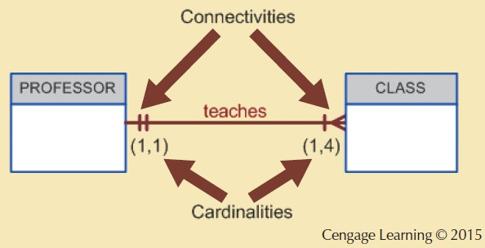
Figure 4.7 - Connectivity and Cardinality
Notes:
In the ERD, cardinality is indicated by placing the appropriate numbers beside the entities, using the format (x,y). The first value represents the minimum number of associated entities, while the second value represents the maximum number of associated entities.
Here, the cardinality (1,4) next to the CLASS entity in the “PROFESSOR teaches CLASS” relationship indicates that each professor teaches up to four classes, which means that the PROFESSOR table’s primary key value occurs at least once and no more than four times as foreign key values in the CLASS table. If the cardinality had been written as (1,N), there would be no upper limit to the number of classes a professor might teach. Similarly, the cardinality (1,1) next to the PROFESSOR entity indicates that each class is taught by one and only one professor. That is, each CLASS entity occurrence is associated with one and only one entity occurrence in PROFESSOR.

Slide 8


Relationship Participation
Optional participation
One entity occurrence does not require a corresponding entity occurrence in a particular relationship
Mandatory participation
One entity occurrence requires a corresponding entity occurrence in a particular relationship
Notes:
If no optionality symbol is depicted with the entity, the entity is assumed to exist in a mandatory relationship with the related entity.

Slide 9
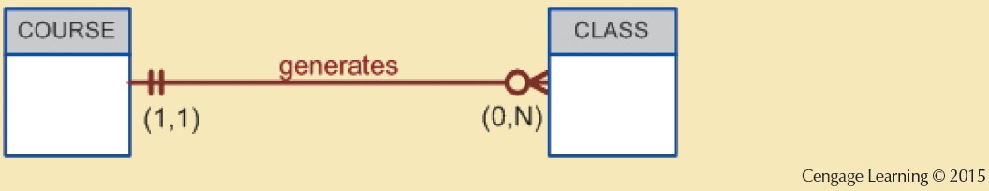
Figure 4.13 - CLASS is Optional to COURSE
Notes:
CLASS is optional. Some courses are taught only once a year and do not generate classes each semester.

Slide 10
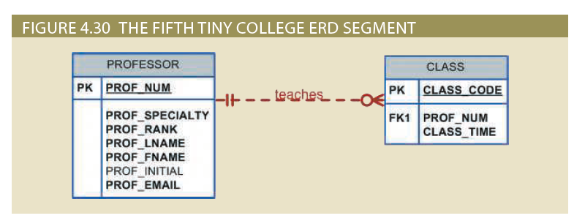
Relationship classification (type):
Cardinality: Class ( , ) professor ( , )

Slide 11
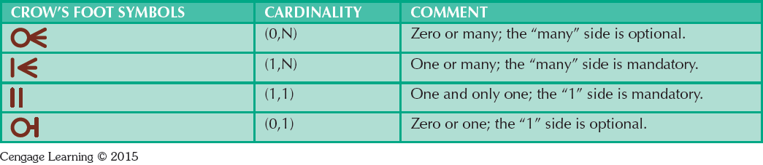
Table 4.3 - Crow’s Foot Symbols

Slide 12
Relationship Strength
Based on how the primary key of a related entity is defined
Weak (non-identifying) relationships
Primary key of the related entity does not contain a primary key component of the parent entity
Strong (identifying) relationships
PK of a child entity contains at least part of its primary key from a parent entity.
Depicted as a solid line in a Crow’s Foot
Notes:
The concept of relationship strength is based on how the primary key of a related entity is defined. To implement a relationship, the primary key of one entity (the parent entity, normally on the “one” side of the one-to-many relationship) appears as a foreign key in the related entity (the child entity, mostly the entity on the “many” side of the one-to-many relationship). Sometimes the foreign key also is a primary key component of that entity.

Slide 13
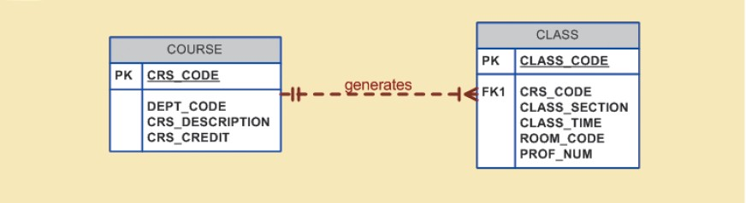
Figure 4.8 - A Weak (Non-Identifying) Relationship between COURSE and CLASS
Cengage Learning © 2015
Notes:
For example, suppose the 1:M relationship between COURSE and CLASS. In this case, a weak relationship exists between COURSE and CLASS because CRS_CODE (the primary key of the parent entity) is only a foreign key in the CLASS entity. In this example, the CLASS primary key did not inherit a primary key component from the COURSE entity.
The CLASS entity is existence-independent on COURSE.
The relationship between COURSE and CLASS is weak.
CLASS is not a week entity.

Slide 14
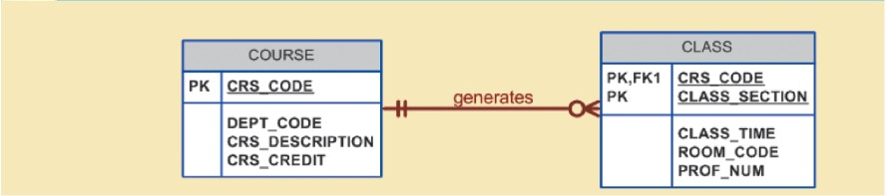
Figure 4.9 - A Strong (Identifying) Relationship between COURSE and CLASS
Cengage Learning © 2015
Notes:
In this case, the CLASS entity primary key is composed of CRS_CODE and CLASS_SECTION. Therefore, a strong relationship exists between COURSE and CLASS because CRS_CODE (the primary key of the parent entity) is a primary key component in the CLASS entity. In other words, the CLASS primary key did inherit a primary key component from the COURSE entity.
The CLASS entity is existence-dependent on COURSE.
The relationship between COURSE and CLASS is strong.
CLASS is a weak entity.

Slide 15
Associative (Composite) Entities
Also known as bridge entities
Used to represent an M:N relationship between two or more entities
Is in a 1:M relationship with the parent entities
*Composed of the primary key attributes of each parent entity
May also contain additional attributes that play no role in connective process
Notes:
The ER model uses the associative entity to represent an M:N relationship between two or more entities. This associative entity is in a 1:M relationship with the parent entities and is composed of the primary key attributes of each parent entity.
Furthermore, the associative entity can have additional attributes of its own.

Slide 16
Figure 4.24/4.25 - A Composite Entity in an ERD
Notes:
Because the M:N relationship between STUDENT and CLASS is decomposed into two 1:M relationships through ENROLL, the relationship participation must be transferred to ENROLL.
It now becomes possible for a class not to occur in ENROLL if no student has signed up for that class. Because a class need not occur in ENROLL, the ENROLL entity becomes optional to CLASS. Also, because the ENROLL entity is created before any students have signed up for a class, the ENROLL entity is also optional to STUDENT, at least initially.

Slide 17

Figure 4.23 - Converting the M:N Relationship into Two 1:M Relationships
Notes:
Note that the composite ENROLL entity is existence-dependent on the other two entities. The composition of the ENROLL entity is based on the primary keys of the entities that are connected by the composite entity. The composite entity may also contain additional attributes that play no role in the connective process. For example, although the entity must be composed of at least the STUDENT and CLASS primary keys, it may also include such additional attributes as grades or absences.

Slide 18

Existence Dependence
Existence dependence
Entity exists in the database only when it is associated with another related entity occurrence
A foreign key attribute cannot be null
Existence independence
Entity exists apart from all of its related entities
Referred to as a strong entity or regular entity
Notes:
An entity is said to be existence-dependent if it can exist in the database only when it is associated with another related entity occurrence.
An entity is existence-dependent if it has a mandatory foreign key—that is, a foreign key attribute that cannot be null.
If an entity can exist apart from all of its related entities, then it is existence-independent, and it is referred to as a strong entity or regular entity.
A mandatory FK condition does not necessarily produce a strong (identifying) relationship. If the FK is not part of the PK, the relationship is weak, regardless of the role it plays in existence-dependency.

Slide 20
Weak Entity
Conditions
The entity must be existence-dependent on its parent entity.
The entity must inherit at least part of its primary key from its parent entity.
Notes:
A weak entity is always existence-dependent on its related entity, because a PK cannot contain nulls. Therefore, a weak entity is one that participates in a strong (identifying) relationship.

Slide 21
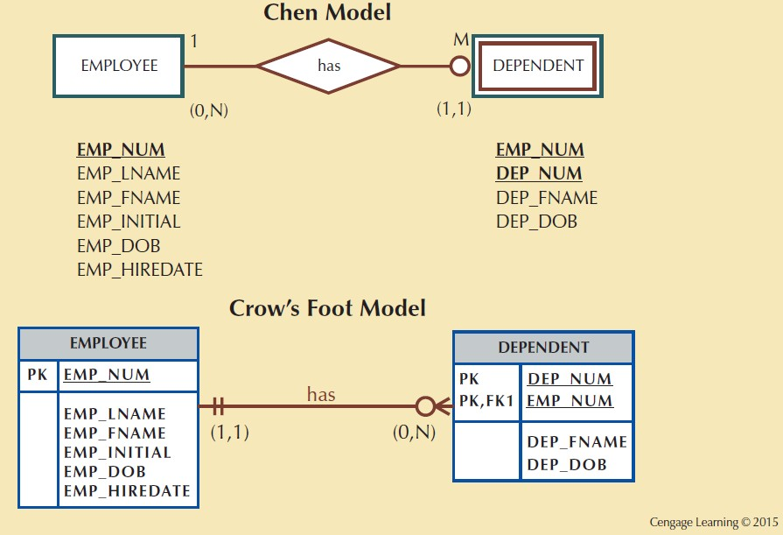
Figure 4.10 - A Weak Entity in an ERD
Notes:
An EMPLOYEE might or might not have a DEPENDENT, but the DEPENDENT must be associated with an EMPLOYEE. Moreover, the DEPENDENT cannot exist without the EMPLOYEE. DEPENDENT is the weak entity in the relationship “EMPLOYEE has DEPENDENT.”

Slide 22
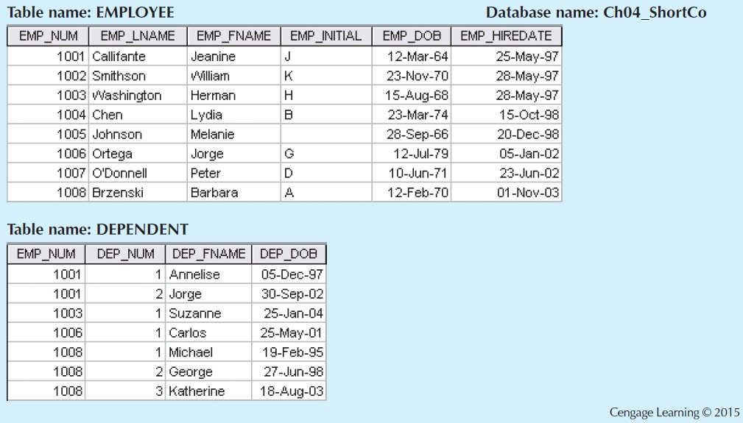
Figure 4.11 - A Weak Entity in a Strong Relationship
Notes:
Remember that the weak entity inherits part of its primary key. Figure 4.11 illustrates the implementation of the relationship between the weak entity (DEPENDENT) and its parent or strong counterpart (EMPLOYEE). Note that DEPENDENT’s primary key is composed of two attributes, EMP_NUM and DEP_NUM, and that EMP_NUM was inherited from EMPLOYEE.

Slide 23
Relationship Degree
Indicates the number of entities or participants associated with a relationship
Unary relationship: Association is maintained within a single entity
Recursive relationship: A recursive relationship exists when an entity is related to itself. For example, a COURSE may be a prerequisite to a COURSE. (p. 133)
Binary relationship: Two entities are associated
Ternary relationship: Three entities are associated
Notes:
A relationship degree indicates the number of entities or participants associated with a relationship. A unary relationship exists when an association is maintained within a single entity. A binary relationship exists when two entities are associated. A ternary relationship exists when three entities are associated.

Slide 24
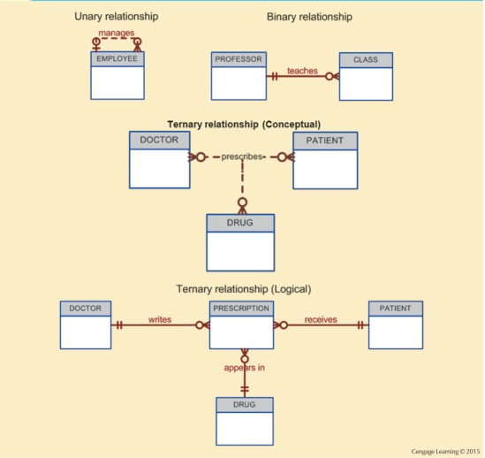
Figure 4.15 - Three Types of Relationship Degree
24
Notes:
Now what we have in prescription ? What are the primary keys we will have in this table? Ask them.
• A DOCTOR writes none or more PRESCRIPTIONs.
• A PATIENT may receive none or more PRESCRIPTIONs.
• A DRUG may appear in none or more PRESCRIPTIONs.

